Slide 1
Text to Video of various PIB Press Releases using Artificial Intelligence /Machine Learning/Generative Adversarial Networks in English and 13 Regional Languages viz. Hindi, Urdu, Punjabi, Gujarati, Marathi, Telugu, Kannada, Malayalam, Tamil, Odia, Bengali, Assamese and Manipuri
CSE7101- Capstone Project
Review-2
Batch Number: PSCS_36
Under the Supervision of,
Dr.Hasan Hussain S
Professor
School of Computer Science and Engineering
Presidency University
Roll Number | Student Name
20221CSE0194 | Tanguturu Rohini Vasavi
20221CSE0200 | Nichenametla Pranathi
20221CSE0198 | Pagade Venkat Sai
Name of the Program: CSE
Name of the HoD: Dr Asif Mohammed
Name of the Program Project Coordinator: Dr. Jayavadivel Ravi
Name of the School Project Coordinators: Dr. Sampath A K , Dr. Geetha A

Slide 2
Problem Statement Number: PSCS_36
Organization: Press Information Bureau (PIB), Government of India
Software :— AI/NLP/TTS/Video Automation System
Problem Description : The Press Information Bureau (PIB), as the Government of India’s primary communication channel, releases official news and press statements in English. However, due to India’s linguistic diversity, these updates need to be made available in multiple regional languages to ensure equitable access to information. Presently, this process involves manual translation, human voiceover recording, and manual video editing—steps that consume significant time and resources, causing delays in news delivery.

Slide 3
Content
Abstract
Litearature Review
System Design
Architecture
Alogorithm Details
Modules Description
Timeline (Gantt Chart)

Slide 4
Abstract :
PIB releases are usually shared in text, but people today prefer videos over long text.
Our solution converts press release text into videos automatically using AI/ML.
It supports 14 languages (English + 13 regional) to reach a wider audience.
Videos are generated with voiceovers.
This makes communication faster, engaging, and accessible to everyone.

Slide 5
Literature Review:
Moviepy — for video creation
gtts — for text-to-speech conversion (audio generation)
PIL (Pillow) — for image processing and manipulation
os — for file and directory management

Slide 6
System Design:
Input Module: Accepts text or script from the user.
Processing Module:
Converts text to speech using gTTS.
Creates and edits video using MoviePy.
Combines audio, images, and background into a single video.
Output Module:
Generates and saves the final video file in .mp4 format
The system follows a simple workflow: Text → Audio → Video → Final Output

Slide 7
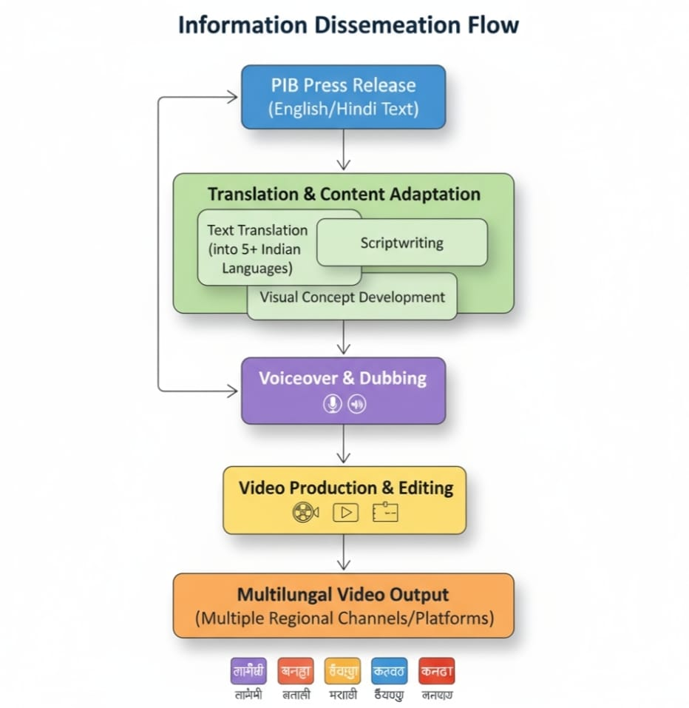
Architecture

Slide 8
Alogorithm Details:
Preprocessing - Tokenization, stop-word removal
Translation - Transformer-based multilingual models
Text-to-Speech - TTS engine for natural narration
Video Composition - Visuals + narration + transitions

Slide 9
Modules Description:
Text Input Collects raw text
Preprocessing - Cleans and summarizes
Translation - Converts to regional languages
TTS Generates narration
Visual Selection Fetches images/videos
Video Composition Combines narration + visuals

Slide 10
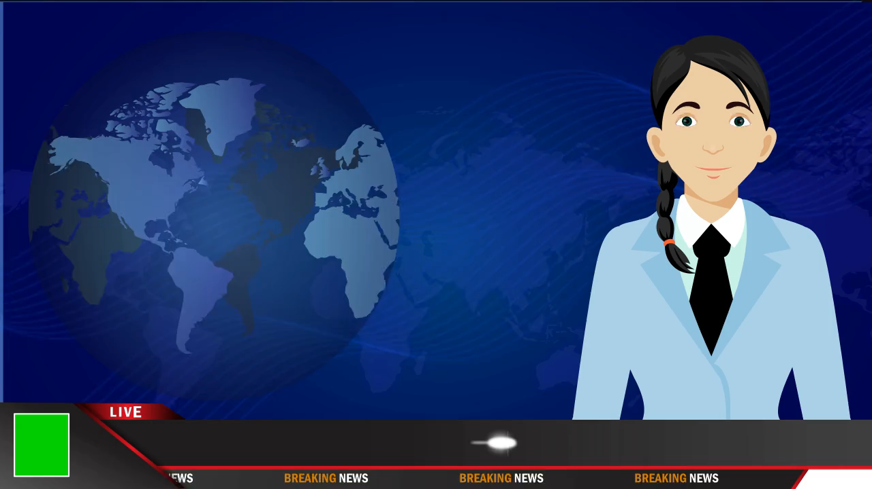
Output:

Slide 11
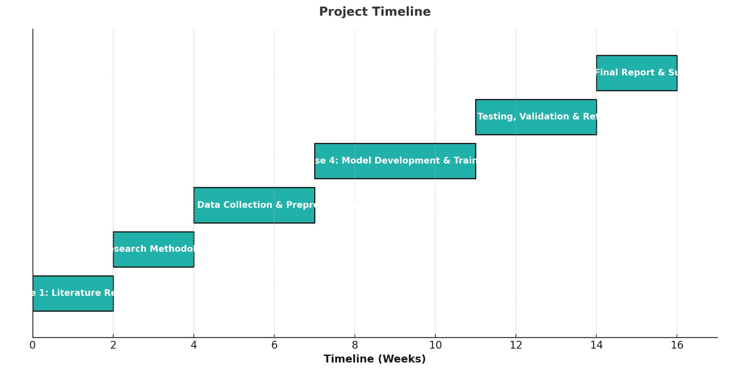
Timeline of the Project (Gantt Chart)

Slide 12
References (IEEE Paper format)
[1] S. Zhuang, K. Li, X. Chen, Y. Wang, Z. Liu, Y. Qiao, and Y. Wang, "Vlogger: Make Your Dream A Vlog," in Proc. IEEE/CVF Conf. Comput. Vis. Pattern Recognit. (CVPR), Seattle, WA, USA, 2024.
[2] S. Zhao et al., "MotionDirector: Motion Customization of Text-to-Video Diffusion Models," in Proc. Eur. Conf. Comput. Vis. (ECCV), 2024.
[3] W. Feng et al., "BlobGEN-Vid: Compositional Text-to-Video Generation with Blob Video Representations," in Proc. IEEE/CVF Conf. Comput. Vis. Pattern Recognit. (CVPR), 2025.

Slide 13


